Slide 1
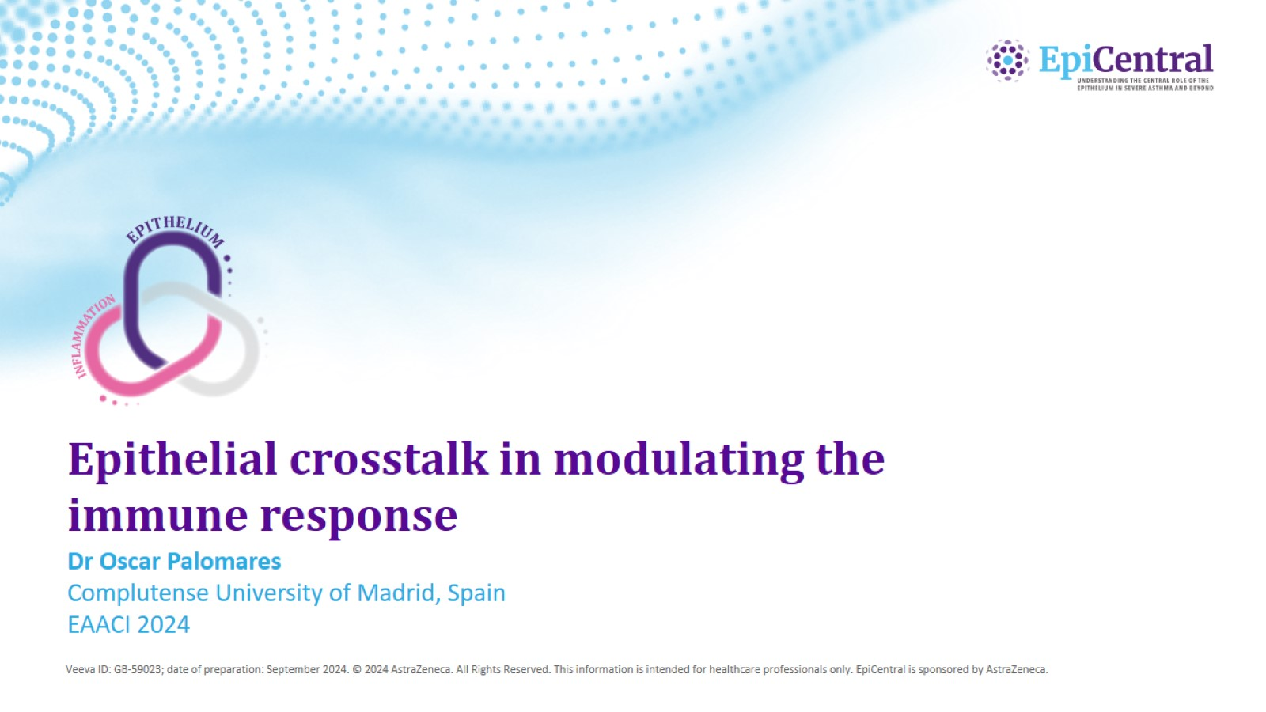
Epithelial crosstalk in modulating the immune response

Slide 2
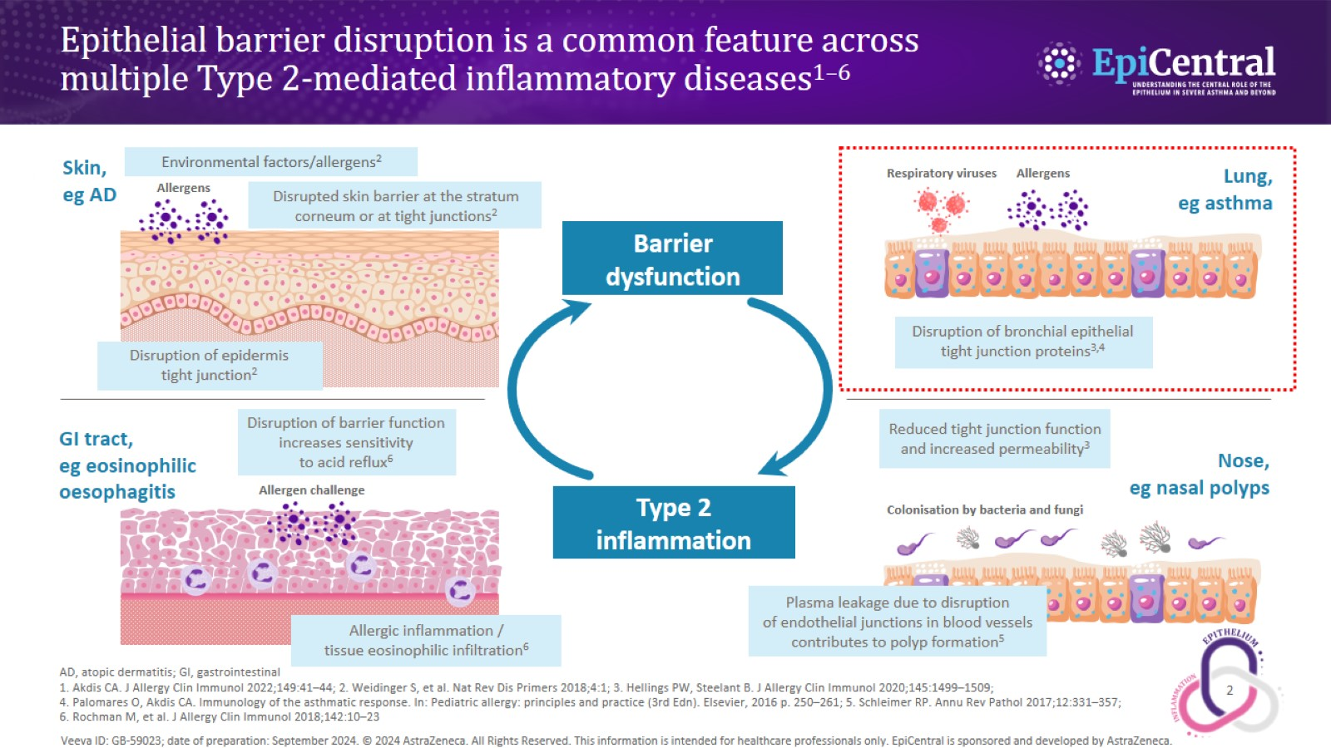
Epithelial barrier disruption is a common feature across multiple Type 2-mediated inflammatory diseases^{1–6}

Slide 3
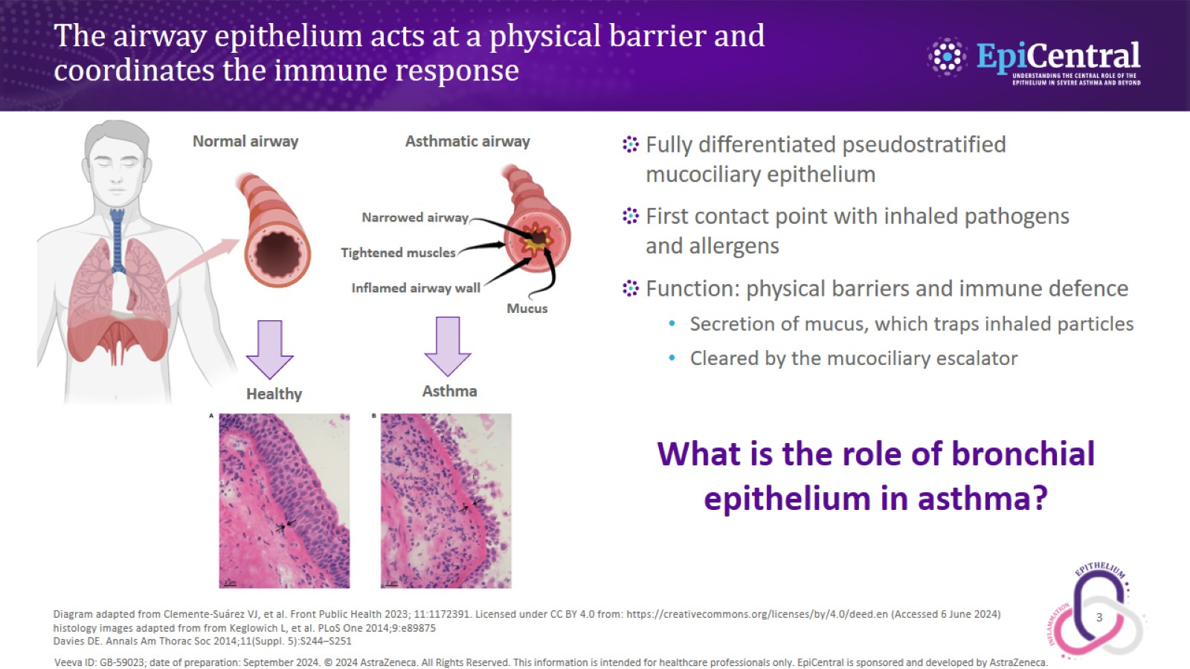
The airway epithelium acts at a physical barrier and coordinates the immune response

Slide 4
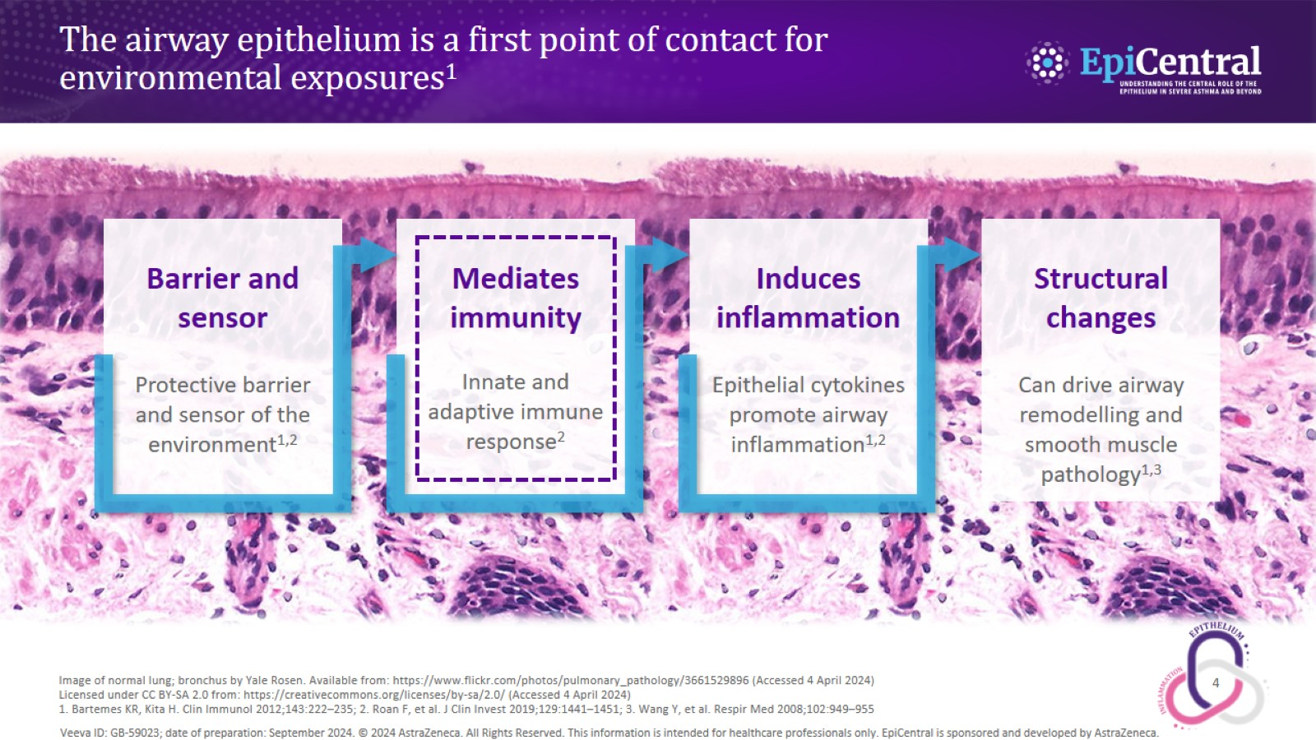
The airway epithelium is a first point of contact for environmental exposures¹

Slide 5
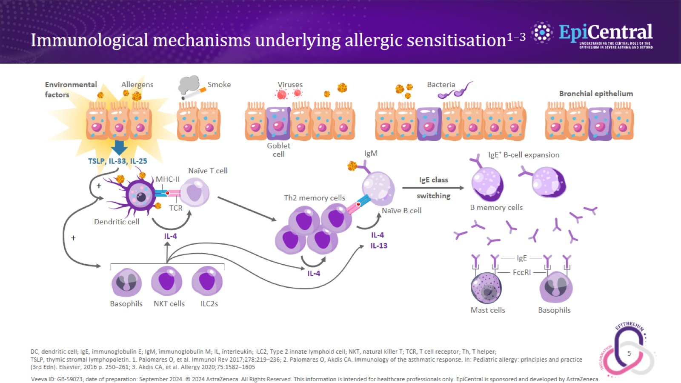
Immunological mechanisms underlying allergic sensitisation^{1–3}

Slide 6
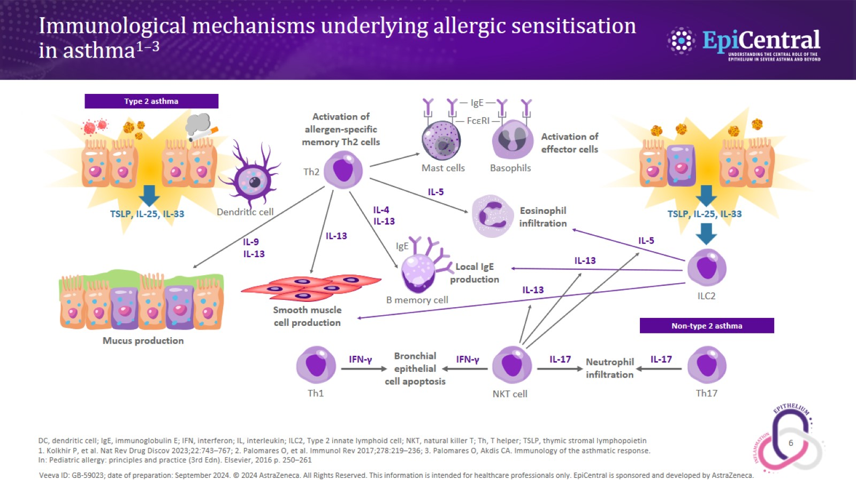
Immunological mechanisms underlying allergic sensitisation in asthma^{1–3}

Slide 7
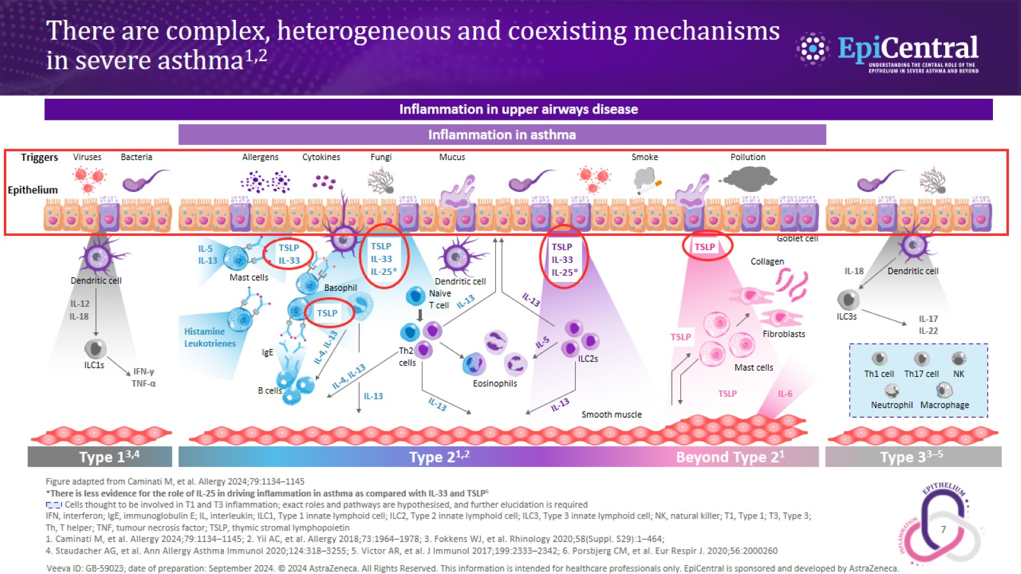
There are complex, heterogeneous and coexisting mechanisms in severe asthma^{1,2}

Slide 8
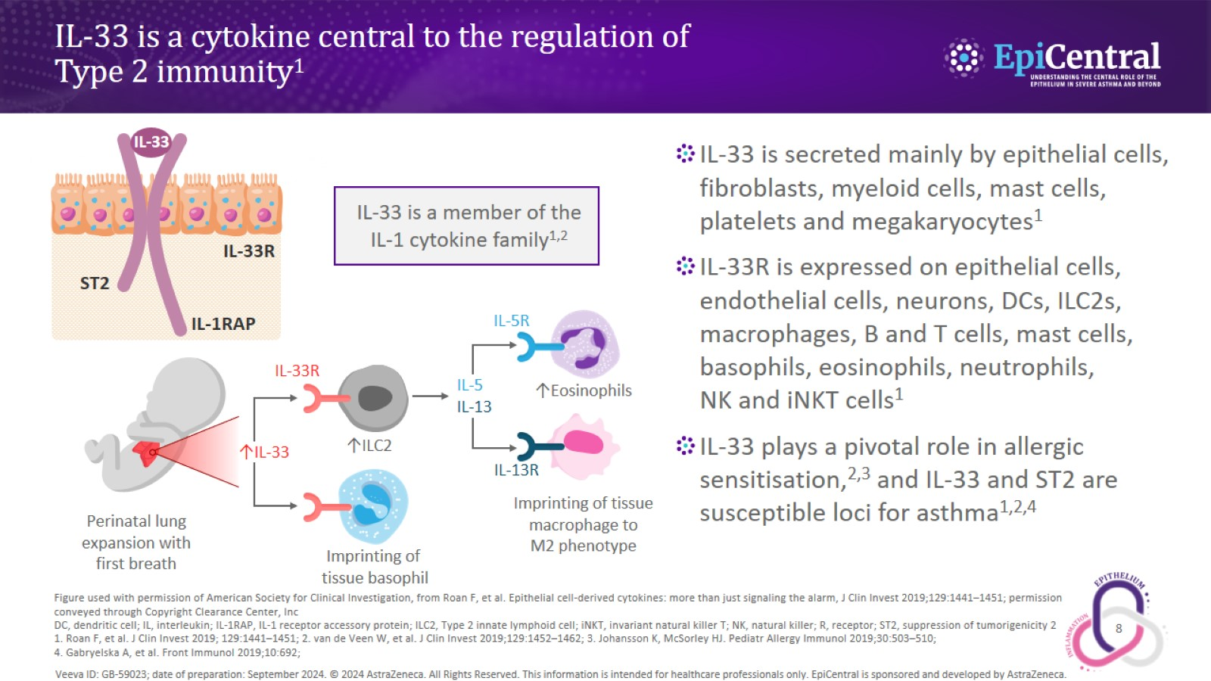
IL-33 is a cytokine central to the regulation of
Type 2 immunity¹

Slide 9
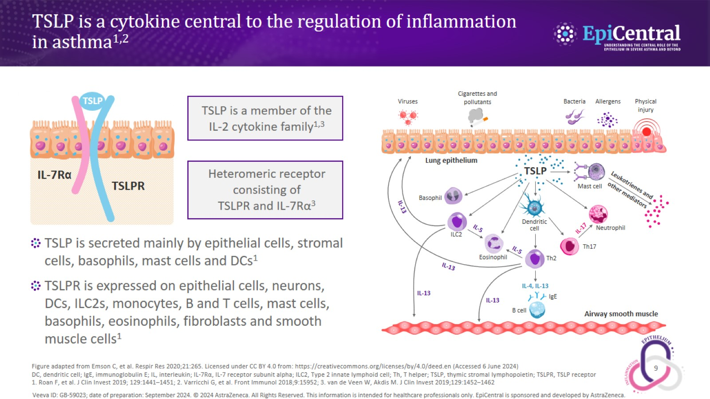
TSLP is a cytokine central to the regulation of inflammation in asthma^{1,2}

Slide 10
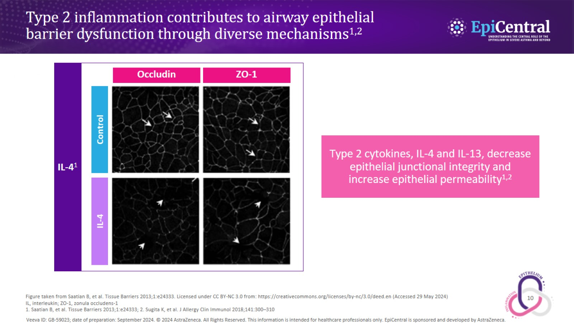
Type 2 inflammation contributes to airway epithelial barrier dysfunction through diverse mechanisms^{1,2}

Slide 11
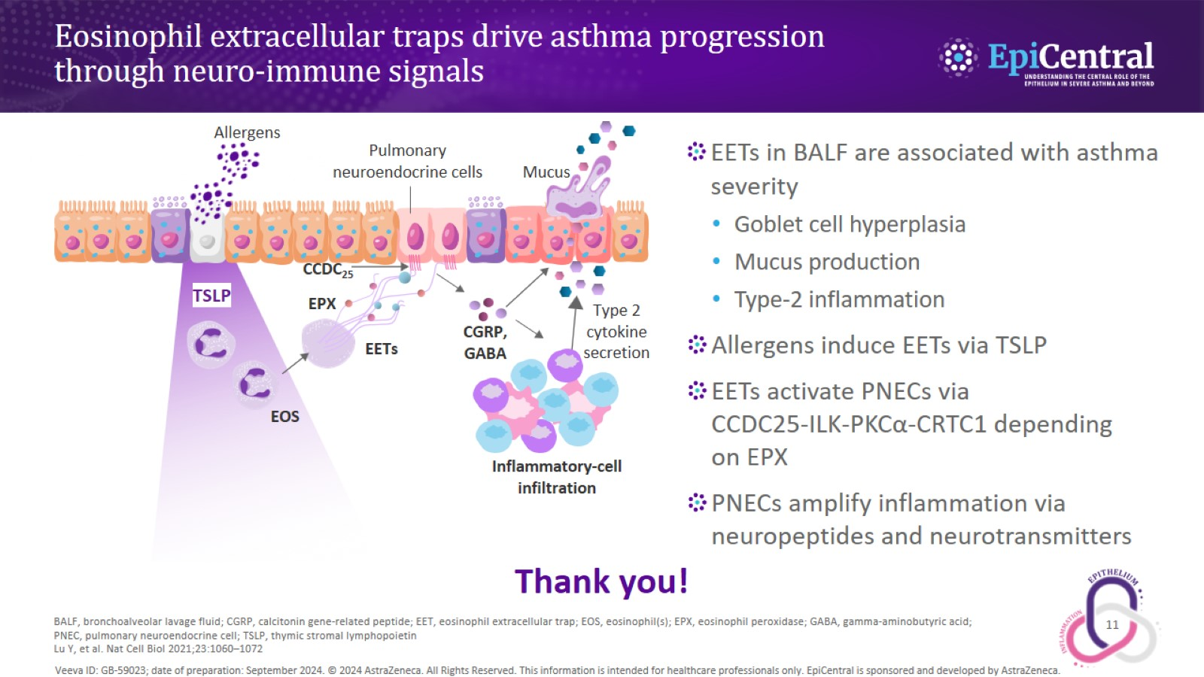
Eosinophil extracellular traps drive asthma progression through neuro-immune signals

